Slide 1
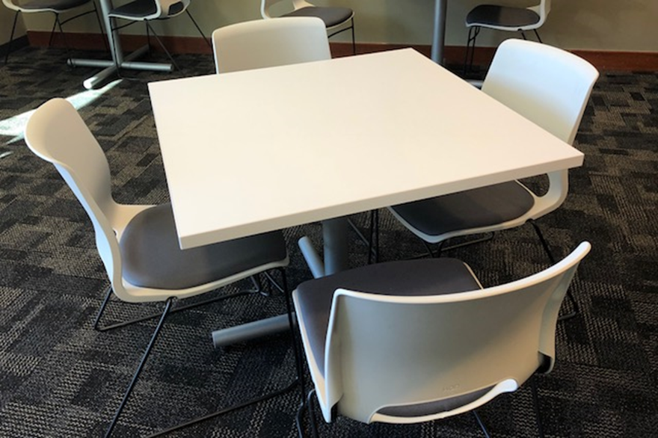
Team 4 SeatIT
Notes:
Hello, I’m Kim Mavrakos from Hackathon Team 4 and I’ll be presenting our idea today. I’ll introduce the remainder of our team as we prepare for questions. We named ourselves SeatIT in honor of our idea.

Slide 2

The Problem & Solution
Problem
Is there somewhere for me to sit in the café right now?
Solution
Alexa, how many seats are available in the cafe?
There are 47 seats available.
Notes:
Our application deals with the cafeteria and available seating. The solution is a sensor that enters data in AWS where the user can query via an Echo device in a common area.

Slide 3
How it works
AWS Database
ECHO / Web interface
PIR Sensor / Pi
Notes:
The user asks “Alexa, how many seats are available in the cafeteria?” The Dot answers “There are 47 seats available.” We know, because we counted, that this is 27% occupancy of the 174 seats.

Slide 4

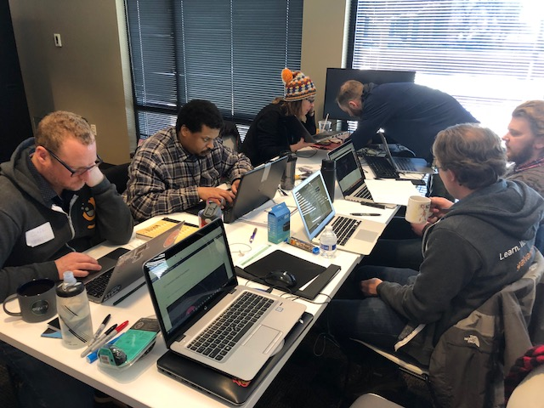
The User Group
Dish Employees/Guests
Facilities Management
Food Service Partner/Brock
Notes:
On occasion, a group of nerds may be occupying a good portion of the cafeteria. People who might like to go relax in the cafeteria would be our obvious users. But facilities management and our food service partner, Brock, would also benefit from the historic data to determine staffing and purchasing needs.

Slide 5
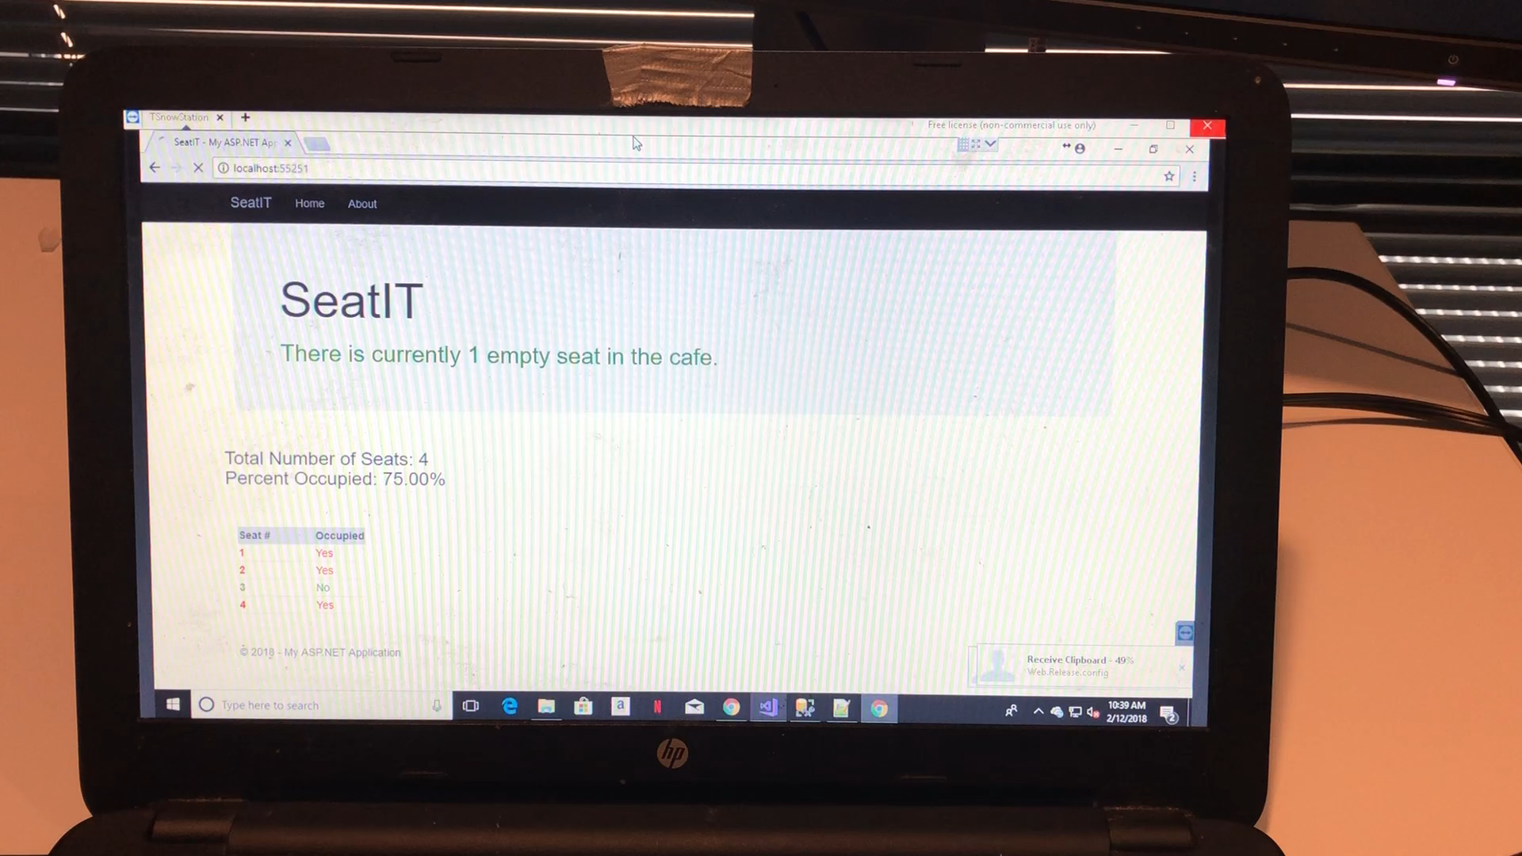
Feasibility Demonstration
Notes:
Here is the application in action.

Slide 6



Feasibility
Financial Considerations
Large Scale Potential
Latency
Notes:
Financial (battery life) link https://monnit.azureedge.net/content/documents/datasheets/sensors/MDS-030-Seat-Sensor-Data-Sheet.pdf
Financial considerations [174 seats * (sensors + power)]. Our sensors cost $10 retail. If DISH purchases in bulk, we imagine the cost could be reduced to $5 per seat (or less), bringing the sensor implementation cost below $1000 for the whole café.
Large Scale Potential – The sky is the limit with this application. There are as many possible installations as there are seats in offices.
Latency – Slower response of the sensors is not an issue, it only needs to be reasonably accurate to allow the user to draw their own conclusions. Knowing there are 12 or 14 seats in the cafeteria doesn’t really change the decision.

Slide 7

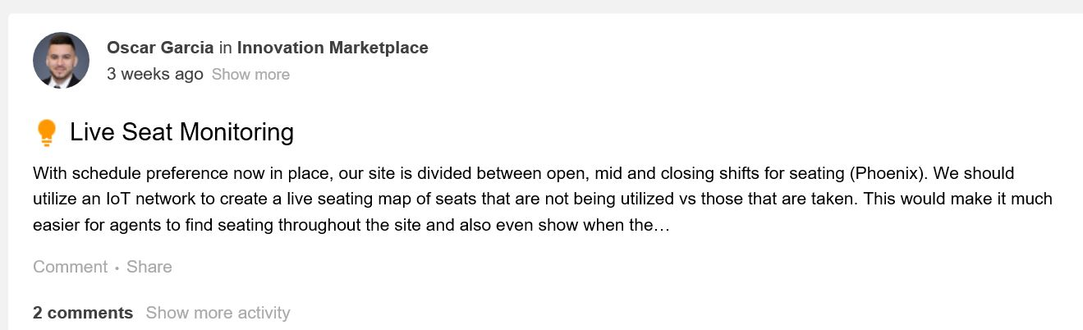
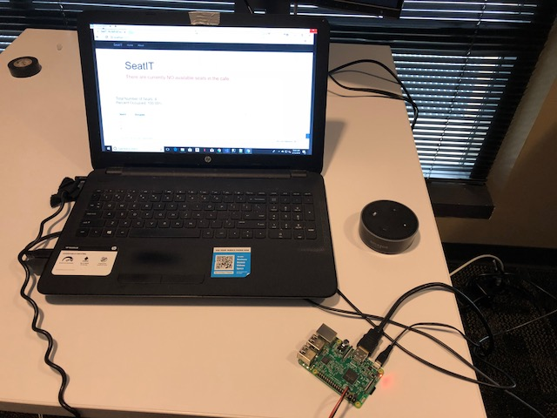
Innovation
Innovation Marketplace
Notes:
As we began thinking about our concept, Paula remembered an idea she saw on innovation marketplace (shout out to Oscar Garcia, a Dr. Dish rep in Arizona). The idea concerned seating in a CSC area and knowing which seats are available. Once we came up with our idea, we’ve seen other application ideas about specific seats available in restaurant, public transit and movie theater applications.

Slide 8
Innovation
FUTURE DEVELOPMENT
Application with map of seats available
Capability to use NBIOT functionality
Smaller, more efficient wireless relay for sensor (particle photon)
Notifications that café is less than 50% occupied
Notes:
However, our idea is a count of seats to determine simple occupancy, contains an on-line application, and, of course, integrates with Alexa.

Slide 9



Usefulness / Utility
Encourages employees to take a break for lunch. Studies confirm this increases employee productivity
Reduces break time hunting for a seat
Fewer wasted trips back and forth if café is too full
History of usage and seating optimization can be mined for insight.
Notes:
As for Usefulness and Utility, this application encourages employees to take a break for lunch. Refreshed employees are productive employees. Also, time spent hunting for a seat will be reduced, and folks on the fourth floor or in building two will no longer trek to the cafeteria, only to find it full. Ultimately, a history of usage and seating data will provide additional information.

Slide 10
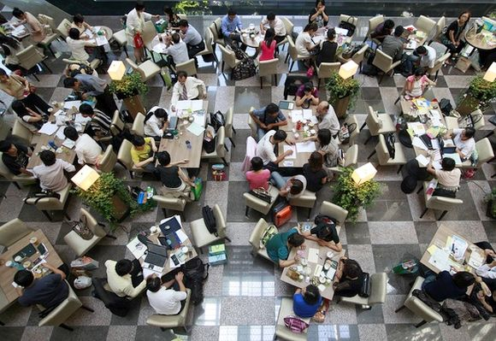
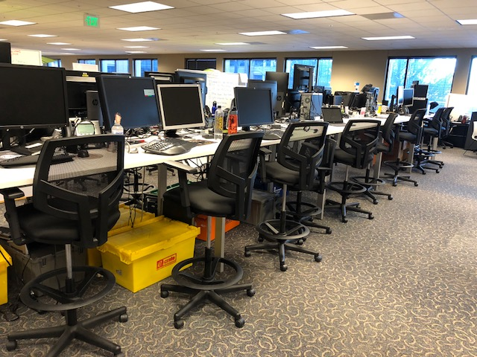
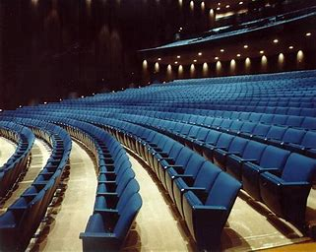
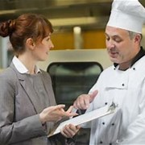
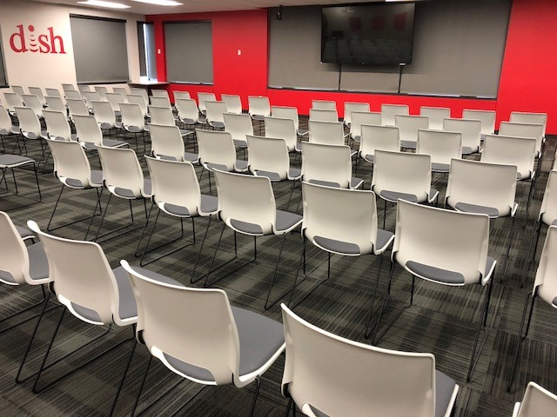
Future Possibilities
Notes:
Subscriptions – Receive a notification when the cafeteria is less than 50% occupied or is approaching your maximum occupancy limit that the user determines.
Planning – Brock and Dish can identify key times for staffing.
Other Locations – Other Conference Rooms, Indoor Seating of Any kind
Asset Tracking – In the last three years, Dish has spent upwards of $500k/year on office chairs that cost from $150 to $500 or more. These assets can roll away, leaving meeting planners hunting for seats in the offices of resourceful employees.

Slide 11
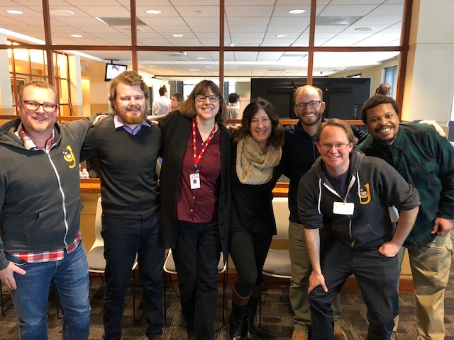
Questions?
Team SeatIT (HAT4)
Paula Robson
Kim Mavrakos
Andrew Lattner
Jonathan Herring (Galvanize)
Clark Newell (Galvanize)
Eric Logue (Galvanize)
Robert Reed

